Slide 1
UNIT- IV
Apriori & FP- Growth Algorithms
A. Phani Sridhar
Associate Professor
Dept of CSE

Slide 2
Basic Concepts
Frequent Itemset Mining Methods
Which Patterns Are Interesting?—Pattern Evaluation Methods
Summary

Slide 3
What Is Frequent Pattern Analysis?
Frequent pattern: a pattern (a set of items, subsequences, substructures, etc.) that occurs frequently in a data set
First proposed by Agrawal, Imielinski, and Swami [AIS93] in the context of frequent itemsets and association rule mining
Motivation: Finding inherent regularities in data
  What products were often purchased together?— Beer and diapers?!
  What are the subsequent purchases after buying a PC?
  What kinds of DNA are sensitive to this new drug?
  Can we automatically classify web documents?
Applications
  Basket data analysis, cross-marketing, catalog design, sale campaign analysis, Web log (click stream) analysis, and DNA sequence analysis.

Slide 4
Why Is Freq. Pattern Mining Important?
Freq. pattern: An intrinsic and important property of datasets
Foundation for many essential data mining tasks
  Association, correlation, and causality analysis
  Sequential, structural (e.g., sub-graph) patterns
  Pattern analysis in spatiotemporal, multimedia, time-series, and stream data
  Classification: discriminative, frequent pattern analysis
  Cluster analysis: frequent pattern-based clustering
  Data warehousing: iceberg cube and cube-gradient
  Semantic data compression: fascicles
  Broad applications

Slide 5
Basic Concepts: Frequent Patterns
Tid | Items bought
10 | Beer, Nuts, Diaper
20 | Beer, Coffee, Diaper
30 | Beer, Diaper, Eggs
40 | Nuts, Eggs, Milk
50 | Nuts, Coffee, Diaper, Eggs, Milk
itemset: A set of one or more items
k-itemset X = {x₁, …, x_{k}}
(absolute) support, or, support count of X: Frequency or occurrence of an itemset X
(relative) support, s, is the fraction of transactions that contains X (i.e., the probability that a transaction contains X)
An itemset X is frequent if X’s support is no less than a minsup threshold
Customer
buys both
Customer
buys diaper
Customer
buys beer

Slide 6
Basic Concepts: Association Rules
Tid
Items bought
Find all the rules X → Y with minimum support and confidence
  support, s, probability that a transaction contains X ∪ Y
  confidence, c, conditional probability that a transaction having X also contains Y
Let minsup = 50%, minconf = 50%
Freq. Pat.: Beer:3, Nuts:3, Diaper:4, Eggs:3, {Beer, Diaper}:3
10
Beer, Nuts, Diaper
20
Beer, Coffee, Diaper
30
Beer, Diaper, Eggs
40
Nuts, Eggs, Milk
50
Nuts, Coffee, Diaper, Eggs, Milk
Customer
buys both
Customer
buys diaper
Customer
buys beer
Association rules: (many more!)
  Beer → Diaper (60%, 100%)
  Diaper → Beer (60%, 75%)

Slide 7
Closed Patterns and Max-Patterns
A long pattern contains a combinatorial number of sub-patterns, e.g., {a₁, …, a₁₀₀} contains (₁₀₀¹) + (₁₀₀²) + … + (₁¹₀⁰₀⁰) = 2¹⁰⁰ – 1 = 1.27*10³⁰ sub-patterns!
Solution: Mine closed patterns and max-patterns instead
An itemset X is closed if X is frequent and there exists no super-pattern Y כ X, with the same support as X (proposed by Pasquier, et al. @ ICDT’99)
An itemset X is a max-pattern if X is frequent and there exists no frequent super-pattern Y כ X (proposed by Bayardo @ SIGMOD’98)
Closed pattern is a lossless compression of freq. patterns
  Reducing the # of patterns and rules

Slide 8
Closed Patterns and Max-Patterns
Exercise. DB = {<a₁, …, a₁₀₀>, < a₁, …, a₅₀>}
  Min_sup = 1.
What is the set of closed itemset?
  <a₁, …, a₁₀₀>: 1
  < a₁, …, a₅₀>: 2
What is the set of max-pattern?
  <a₁, …, a₁₀₀>: 1
What is the set of all patterns?
  !!

Slide 9
Chapter 5: Mining Frequent Patterns, Association and Correlations: Basic Concepts and Methods
Basic Concepts
Frequent Itemset Mining Methods
Which Patterns Are Interesting?—Pattern Evaluation Methods
Summary

Slide 10
Scalable Frequent Itemset Mining Methods
Apriori: A Candidate Generation-and-Test Approach
Improving the Efficiency of Apriori
FPGrowth: A Frequent Pattern-Growth Approach
ECLAT: Frequent Pattern Mining with Vertical Data Format

Slide 11
The Downward Closure Property and Scalable Mining Methods
The downward closure property of frequent patterns
  Any subset of a frequent itemset must be frequent
  If {beer, diaper, nuts} is frequent, so is {beer, diaper}
  i.e., every transaction having {beer, diaper, nuts} also contains {beer, diaper}
Scalable mining methods: Three major approaches
  Apriori (Agrawal & Srikant@VLDB’94)
  Freq. pattern growth (FPgrowth—Han, Pei & Yin @SIGMOD’00)
  Vertical data format approach (Charm—Zaki & Hsiao @SDM’02)

Slide 12
Apriori: A Candidate Generation & Test Approach
Apriori pruning principle: If there is any itemset which is infrequent, its superset should not be generated/tested! (Agrawal & Srikant @VLDB’94, Mannila, et al. @ KDD’ 94)
Method:
  Initially, scan DB once to get frequent 1-itemset
  Generate length (k+1) candidate itemsets from length k frequent itemsets
  Test the candidates against DB
  Terminate when no frequent or candidate set can be generated

Slide 13
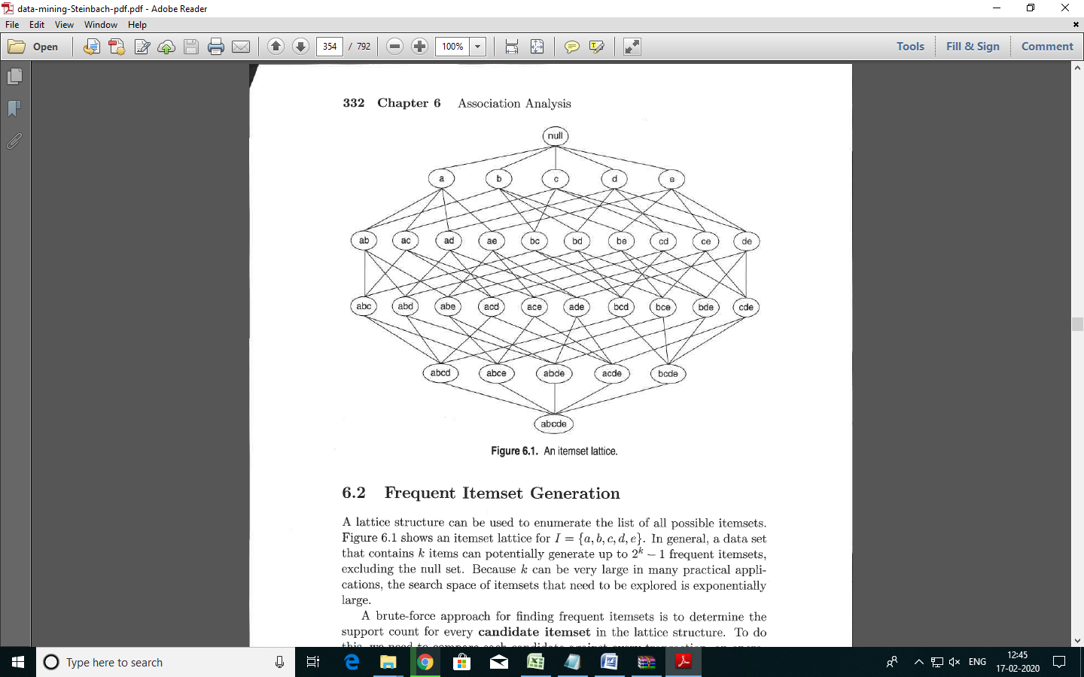
Frequent Itemset Lattice

Slide 14
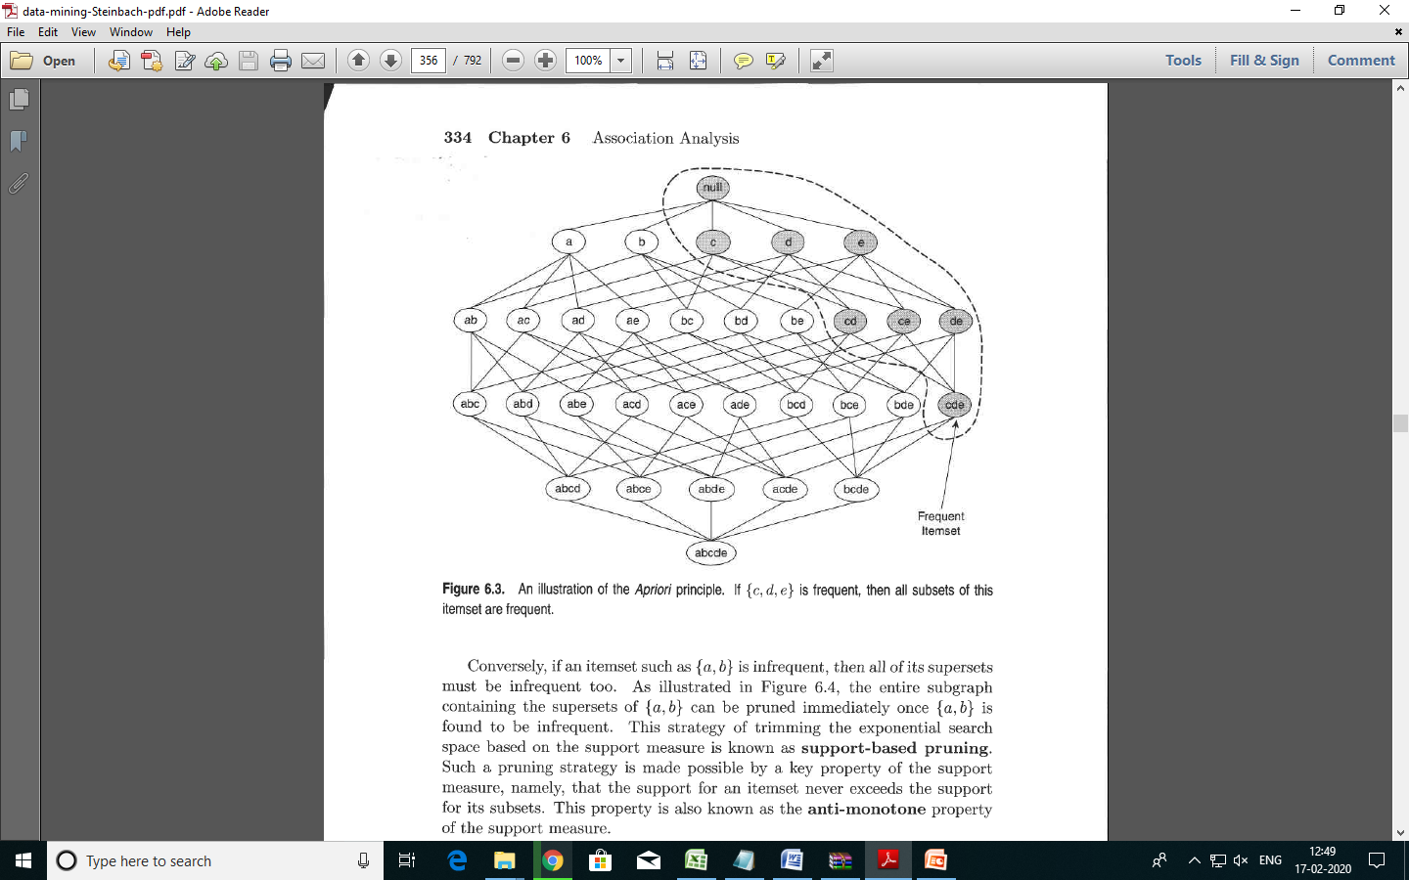
Downward Closure Property

Slide 15
The Apriori Algorithm—An Example
Sup_{min} = 2
Itemset | sup
{A} | 2
{B} | 3
{C} | 3
{D} | 1
{E} | 3
Database TDB
Itemset | sup
{A} | 2
{B} | 3
{C} | 3
{E} | 3
L₁
Tid | Items
10 | A, C, D
20 | B, C, E
30 | A, B, C, E
40 | B, E
C₁
1st scan
C₂
Itemset | sup
{A, B} | 1
{A, C} | 2
{A, E} | 1
{B, C} | 2
{B, E} | 3
{C, E} | 2
C₂
L₂
Itemset
{A, B}
{A, C}
{A, E}
{B, C}
{B, E}
{C, E}
Itemset | sup
{A, C} | 2
{B, C} | 2
{B, E} | 3
{C, E} | 2
2nd scan
C₃
Itemset
{B, C, E}
3rd scan
L₃
Itemset | sup
{B, C, E} | 2

Slide 16
support and confidence.
Support for a rule R is the ratio of the number of occurrences of R, given all occurrences of all rules.
Confidence of a rule X->Y, is the ratio of the number of occurrences of Y given X, among all other occurrences given X.

Slide 17
Generating rules: an example
Suppose {B,C,E} is frequent, with sup=50%
  Proper nonempty subsets: {B,C}, {B,E}, {C,E}, {B}, {C}, {E}, with sup=50%, 50%, 75%, 75%, 75%, 75% respectively
  These generate these association rules:
    B,C → E Support = confidence= %
    B,E → C Support = confidence= %
    C,E → B Support = confidence= %
    B → C,E Support = confidence= %
    C → B,E Support = confidence= %
    E → B,C Support = confidence= %
    All rules have support = 50%
CS583, Bing Liu, UIC

Slide 18
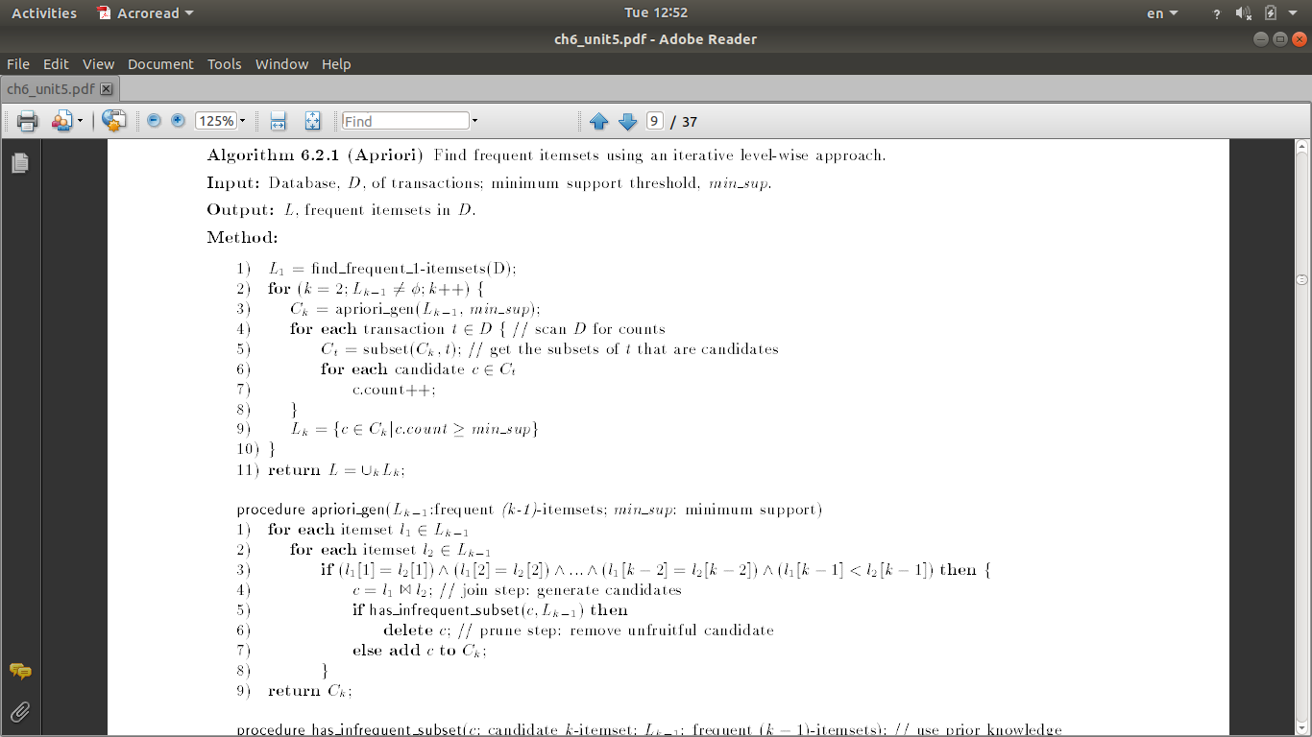

Slide 19
The Apriori Algorithm (Pseudo-Code)
C_{k}: Candidate itemset of size k
L_{k} : frequent itemset of size k
L₁ = {frequent items};
for (k = 1; L_{k} !=∅; k++) do begin
C_{k+1} = candidates generated from L_{k};
for each transaction t in database do
  increment the count of all candidates in C_{k+1} that are contained in t
L_{k+1} = candidates in C_{k+1} with min_support
end
return ∪_{k} L_{k};

Slide 20
Implementation of Apriori
How to generate candidates?
  Step 1: self-joining L_{k}
  Step 2: pruning
Example of Candidate-generation
  L₃={abc, abd, acd, ace, bcd}
  Self-joining: L₃*L₃
    abcd from abc and abd
    acde from acd and ace
  Pruning:
    acde is removed because ade is not in L₃
  C₄ = {abcd}

Slide 21
How to Count Supports of Candidates?
Why counting supports of candidates a problem?
  The total number of candidates can be very huge
  One transaction may contain many candidates
Method:
  Candidate itemsets are stored in a hash-tree
  Leaf node of hash-tree contains a list of itemsets and counts
  Interior node contains a hash table
  Subset function: finds all the candidates contained in a transaction

Slide 22
Counting Supports of Candidates Using Hash Tree
Subset function
Transaction: 1 2 3 5 6
3,6,9
1,4,7
2,5,8
1 + 2 3 5 6
1 3 + 5 6
2 3 4
5 6 7
1 4 5
3 4 5
3 5 6
3 5 7
6 8 9
3 6 7
3 6 8
1 3 6
1 2 + 3 5 6
1 2 4
4 5 7
1 2 5
4 5 8
1 5 9

Slide 23
Scalable Frequent Itemset Mining Methods
Apriori: A Candidate Generation-and-Test Approach
Improving the Efficiency of Apriori
FPGrowth: A Frequent Pattern-Growth Approach
ECLAT: Frequent Pattern Mining with Vertical Data Format
Mining Close Frequent Patterns and Maxpatterns

Slide 24
Further Improvement of the Apriori Method
Major computational challenges
  Multiple scans of transaction database
  Huge number of candidates
  Tedious workload of support counting for candidates
Improving Apriori: general ideas
  Reduce passes of transaction database scans
  Shrink number of candidates
  Facilitate support counting of candidates

Slide 25
Partition: Scan Database Only Twice
Any itemset that is potentially frequent in DB must be frequent in at least one of the partitions of DB
  Scan 1: partition database and find local frequent patterns
  Scan 2: consolidate global frequent patterns
A. Savasere, E. Omiecinski and S. Navathe, VLDB’95
DB₁
+
DB₂
+
+
DB_{k}
= DB
sup₁(i) < σDB₁
sup₂(i) < σDB₂
sup_{k}(i) < σDB_{k}
sup(i) < σDB

Slide 26
DHP: Reduce the Number of Candidates
A k-itemset whose corresponding hashing bucket count is below the threshold cannot be frequent
  Candidates: a, b, c, d, e
  Hash entries
    {ab, ad, ae}
    {bd, be, de}
    …
  Frequent 1-itemset: a, b, d, e
  ab is not a candidate 2-itemset if the sum of count of {ab, ad, ae} is below support threshold
J. Park, M. Chen, and P. Yu. An effective hash-based algorithm for mining association rules. SIGMOD’95
count
itemsets
35
{ab, ad, ae}
88
{bd, be, de}
...
...
102
{yz, qs, wt}
Hash Table

Slide 27
Scalable Frequent Itemset Mining Methods
Apriori: A Candidate Generation-and-Test Approach
Improving the Efficiency of Apriori
FPGrowth: A Frequent Pattern-Growth Approach
ECLAT: Frequent Pattern Mining with Vertical Data Format
Mining Close Frequent Patterns and Maxpatterns

Slide 28
The Frequent Pattern Growth Mining Method
Idea: Frequent pattern growth
  Recursively grow frequent patterns by pattern and database partition
Method
  For each frequent item, construct its conditional pattern-base, and then its conditional FP-tree
  Repeat the process on each newly created conditional FP-tree
  Until the resulting FP-tree is empty, or it contains only one path—single path will generate all the combinations of its sub-paths, each of which is a frequent pattern

Slide 29
Pattern-Growth Approach: Mining Frequent Patterns Without Candidate Generation
Bottlenecks of the Apriori approach
  Breadth-first (i.e., level-wise) search
  Candidate generation and test
    Often generates a huge number of candidates
The FPGrowth Approach (J. Han, J. Pei, and Y. Yin, SIGMOD’ 00)
  Depth-first search
  Avoid explicit candidate generation
Major philosophy: Grow long patterns from short ones using local frequent items only
  “abc” is a frequent pattern
  Get all transactions having “abc”, i.e., project DB on abc: DB|abc
  “d” is a local frequent item in DB|abc → abcd is a frequent pattern

Slide 30
Construct FP-tree from a Transaction Database
TID Items bought (ordered) frequent items
100 {f, a, c, d, g, i, m, p} {f, c, a, m, p}
200 {a, b, c, f, l, m, o} {f, c, a, b, m}
300 {b, f, h, j, o, w} {f, b}
400 {b, c, k, s, p} {c, b, p}
500 {a, f, c, e, l, p, m, n} {f, c, a, m, p}
min_support = 3
{}
Header Table
Item frequency head
f 4
c 4
a 3
b 3
m 3
p 3
Scan DB once, find frequent 1-itemset (single item pattern)
Sort frequent items in frequency descending order, f-list
Scan DB again, construct FP-tree
f:4
c:1
c:3
b:1
b:1
a:3
p:1
m:2
b:1
F-list = f-c-a-b-m-p
p:2
m:1

Slide 31
Partition Patterns and Databases
Frequent patterns can be partitioned into subsets according to f-list
  F-list = f-c-a-b-m-p
  Patterns containing p
  Patterns having m but no p
  …
  Patterns having c but no a nor b, m, p
  Pattern f
Completeness and non-redundency

Slide 32
Find Patterns Having P From P-conditional Database
Starting at the frequent item header table in the FP-tree
Traverse the FP-tree by following the link of each frequent item p
Accumulate all of transformed prefix paths of item p to form p’s conditional pattern base
{}
Header Table
Item frequency head
f 4
c 4
a 3
b 3
m 3
p 3
f:4
c:1
Conditional pattern bases
item cond. pattern base
c f:3
a fc:3
b fca:1, f:1, c:1
m fca:2, fcab:1
p fcam:2, cb:1
c:3
b:1
b:1
a:3
p:1
m:2
b:1
p:2
m:1

Slide 33
From Conditional Pattern-bases to Conditional FP-trees
For each pattern-base
  Accumulate the count for each item in the base
  Construct the FP-tree for the frequent items of the pattern base
m-conditional pattern base:
  fca:2, fcab:1
{}
Header Table
Item frequency head
f 4
c 4
a 3
b 3
m 3
p 3
f:4
c:1
All frequent patterns relate to m
m,
fm, cm, am,
fcm, fam, cam,
fcam
{}
c:3
b:1
b:1

f:3

a:3
p:1
m:2
b:1
c:3
p:2
m:1
a:3
m-conditional FP-tree

Slide 34
Recursion: Mining Each Conditional FP-tree
{}
{}
Cond. pattern base of “am”: (fc:3)
f:3
c:3
f:3
am-conditional FP-tree
c:3
{}
Cond. pattern base of “cm”: (f:3)
a:3
f:3
m-conditional FP-tree
cm-conditional FP-tree
{}
Cond. pattern base of “cam”: (f:3)
f:3
cam-conditional FP-tree

Slide 35
Benefits of the FP-tree Structure
Completeness
  Preserve complete information for frequent pattern mining
  Never break a long pattern of any transaction
Compactness
  Reduce irrelevant info—infrequent items are gone
  Items in frequency descending order: the more frequently occurring, the more likely to be shared
  Never be larger than the original database (not count node-links and the count field)

Slide 36
Scaling FP-growth by Database Projection
What about if FP-tree cannot fit in memory?
  DB projection
First partition a database into a set of projected DBs
Then construct and mine FP-tree for each projected DB
Parallel projection vs. partition projection techniques
  Parallel projection
    Project the DB in parallel for each frequent item
    Parallel projection is space costly
    All the partitions can be processed in parallel
  Partition projection
    Partition the DB based on the ordered frequent items
    Passing the unprocessed parts to the subsequent partitions

Slide 37
Partition-Based Projection
Parallel projection needs a lot of disk space
Partition projection saves it
Tran. DB
fcamp
fcabm
fb
cbp
fcamp
p-proj DB
fcam
cb
fcam
m-proj DB
fcab
fca
fca
b-proj DB
f
cb
…
a-proj DB
fc
…
c-proj DB
f
…
f-proj DB
…
am-proj DB
fc
fc
fc
cm-proj DB
f
f
f
…

Slide 38


Performance of FPGrowth in Large Datasets
Data set T25I20D10K
Data set T25I20D100K
FP-Growth vs. Apriori
FP-Growth vs. Tree-Projection

Slide 39
Advantages of the Pattern Growth Approach
Divide-and-conquer:
  Decompose both the mining task and DB according to the frequent patterns obtained so far
  Lead to focused search of smaller databases
Other factors
  No candidate generation, no candidate test
  Compressed database: FP-tree structure
  No repeated scan of entire database
  Basic ops: counting local freq items and building sub FP-tree, no pattern search and matching
A good open-source implementation and refinement of FPGrowth
  FPGrowth+ (Grahne and J. Zhu, FIMI'03)

Slide 40
Summary
Basic concepts: association rules, support-confident framework, closed and max-patterns
Scalable frequent pattern mining methods
  Apriori (Candidate generation & test)
  Projection-based (FP- growth)

Slide 41
Ref: Basic Concepts of Frequent Pattern Mining
(Association Rules) R. Agrawal, T. Imielinski, and A. Swami. Mining association rules between sets of items in large databases. SIGMOD'93
(Max-pattern) R. J. Bayardo. Efficiently mining long patterns from databases. SIGMOD'98
(Closed-pattern) N. Pasquier, Y. Bastide, R. Taouil, and L. Lakhal. Discovering frequent closed itemsets for association rules. ICDT'99
(Sequential pattern) R. Agrawal and R. Srikant. Mining sequential patterns. ICDE'95

